Slide 1
Group 5:
Personal Finance
Tra My Sitz, Oleksandr Kotkov, Ovidio Herrera, Robinson Quiroz

Slide 2
STRUCTURE
Task definition
Functionality & Components
Splitwise Integration & Transaction input
Currency Conversion (€) & Income Accountability
Prediction & Reporting
Graphic User Interface
Limitations and Improvements

Slide 3
1
Task Definition

Slide 4

TASK DEFINITION
Aim: enhance Splitwise service functionality.
Data source:
data received from the Splitwise API, user input, currency exchange rates API.
The solution provides reports of expenses and income
For the development purpose a Splitwise account of imaginary person Max Mustermann, his Mom and wife were created

Slide 5
2.1
Splitwise Integration
and
Transaction input

Slide 6
2.1.1 Splitwise integration
Establish connection with Splitwise and .sqlite database
def splitwise_sync(s_obj: Splitwise):
user = s_obj.getCurrentUser()
user_id = user.getId()
conn = None
cursor = None
try:
conn = sqlite3.connect(str(user_id) + ".sqlite")
cursor = conn.cursor()
except Error as e:
print(e)

Slide 7
2.1.1 Splitwise integration
Create tables in database
def create_tables(cursor):
cursor.execute("CREATE TABLE IF NOT EXISTS Users("
"id integer PRIMARY KEY,"
"full_name text,"
"email text)")
cursor.execute("CREATE TABLE IF NOT EXISTS Groups_users("
"id integer PRIMARY KEY,"
"group_name text,"
"group_type text)")

Slide 8
2.1.1 Splitwise integration
Fill tables in database
def fill_tables(s_obj: Splitwise, cursor):
user = s_obj.getCurrentUser()
# Insert information about current user in Users table
cursor.execute("INSERT OR IGNORE INTO Users (id,full_name,email) VALUES (?,?,?)",
[user.getId(), user.getFirstName() + " " + user.getLastName(), user.getEmail()])
# Get list of friends of a current user, insert information about them in Users table
other_users = s_obj.getFriends()
for u in other_users:
cursor.execute("INSERT OR IGNORE INTO Users (id,full_name,email) VALUES (?,?,?)",
[u.getId(), u.getFirstName() + " " + u.getLastName(), u.getEmail()])
# Insert information about groups in Groups_users table
groups = s_obj.getGroups()
for g in groups:
cursor.execute("INSERT OR IGNORE INTO Groups_users (id,group_name,group_type) VALUES (?,?,?)",
[g.getId(), g.getName(), g.getType()])

Slide 9
2.1.2 Transaction input
def insert_category(conn, cursor, category_id: int, category_name: str):
try:
cursor.execute("INSERT INTO Categories (id,category_name) VALUES (?,?)",
[category_id, category_name])
conn.commit()
except sqlite3.IntegrityError as err:
if str(err) == "UNIQUE constraint failed: Categories.id":
result = cursor.execute("SELECT * FROM Categories WHERE id = (?)",
[category_id])
print("Error - a category with id " + str(category_id) + " already exists: " + str(result.fetchone()))
if str(err) == "UNIQUE constraint failed: Categories.category_name":
result = cursor.execute("SELECT * FROM Categories WHERE category_name = (?)",
[category_name])
print("Error - a category with name " + str(category_name) + " already exists: " + str(result.fetchone()))

Slide 10
2.1.2 Transaction input
def insert_subcategory(conn, cursor, subcategory_id: int, category_id: int, subcategory_name: str):
try:
cursor.execute("INSERT INTO Subcategories (id,category_id,subcategory_name) VALUES (?,?,?)",
[subcategory_id, category_id, subcategory_name])
conn.commit()
except sqlite3.IntegrityError as err:
if str(err) == "UNIQUE constraint failed: Subcategories.id":
result = cursor.execute("SELECT * FROM Subcategories WHERE id = (?)",
[subcategory_id])
print("Error - a subcategory with id " + str(subcategory_id) + " already exists: " + str(result.fetchone()))
if str(err) == "UNIQUE constraint failed: Subcategories.subcategory_name":
result = cursor.execute("SELECT * FROM Subcategories WHERE subcategory_name = (?)",
[subcategory_name])
print("Error - a subcategory with name " + str(subcategory_name) + " already exists: " + str(result.fetchone()))
if str(err) == "FOREIGN KEY constraint failed":
print("Error - a category with id " + str(category_id) + " does not exist.")

Slide 11
2.1.2 Transaction input
def insert_transaction(conn, cursor, transaction_date: str, group_id: int, subcategory_id: int,
description: str, currency_code: str, repeat_interval: str):
try:
cursor.execute("INSERT INTO Transactions (expense_date,group_id,subcategory_id,"
"description,currency_code,repeat_interval) VALUES (?,?,?,?,?,?)",
[transaction_date, group_id, subcategory_id, description,currency_code,repeat_interval])
conn.commit()
except sqlite3.IntegrityError as err:
if str(err) == "FOREIGN KEY constraint failed":
print("Error - such group id or subcategory id does not exist.")
else:
print(err)

Slide 12
2.1.2 Transaction input
def insert_transaction_item(conn, cursor, transaction_id: int, user_id: int, amount: int):
try:
cursor.execute("INSERT INTO TransactionItems (transaction_id, user_id, amount) VALUES (?,?,?)",
[transaction_id, user_id, amount])
conn.commit()
except sqlite3.IntegrityError as err:
if str(err) == "FOREIGN KEY constraint failed":
print("Error - such transaction id or user id does not exist.")
else:
print(err)

Slide 13
2.2
Currency Conversion
and
Accountability

Slide 14
2.2.1 Currency Conversion
sql_currency.py
Converts Splitwise Transactions recorded in foreign
currency to Euros (€)
def currency(s_obj: Splitwise, settings: dict):
df_sql = symbol_date_sqldf(s_obj)
status = fixer_api_latest(settings)

Slide 15
2.2.1 Currency Conversion
fixer_api_latest()
API today's currency rates -> local json file
if API connection error -> read last saved json file
prevents application interruptions

Slide 16
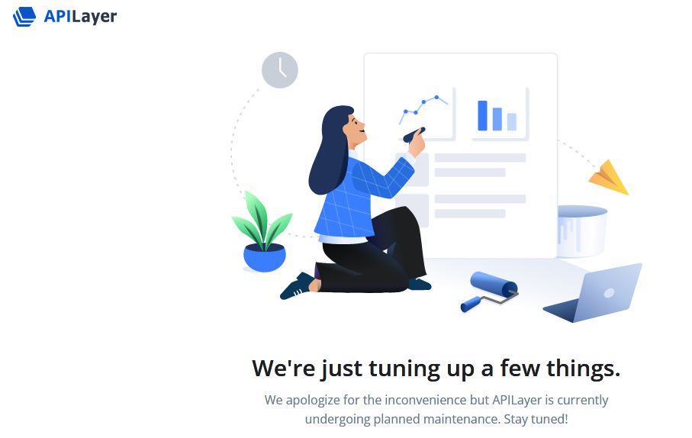



2.2.1 Currency Conversion

Slide 17
2.2.1 Currency Conversion
symbol_date_sqldf()
transactions df (pandas) from local sql (Splitwise)
currency()
converts df foreign currency transactions to €
writes these values in sql database

Slide 18
2.2.2 Accountability
unrect_transac.py
Allows user to balance his accounts
Requests from Splitwise debt records for user’s friends in any currency such debt is recorded

Slide 19
2.2.2 Accountability
unrec_trans <, =, > income - expense + owes - owed
unrect_trans = 0 -> income + owes = expenses + owed
unrect_trans <[>] 0 -> PseudoIncome <[>] PseudoExpenses

Slide 20
2.2.2 unrec transactions and fact balance
unrec_trans = income - expense + owes - owed -(-fact_bal)
it balances to zero when
unrect_trans = -(-fact_bal) = fact_bal

Slide 21
2.2.2 Accountability
fact balance will be recorded as income transaction:
if fact balance > 0 -> positive transaction
if fact balance < 0 -> negative transaction

Slide 22
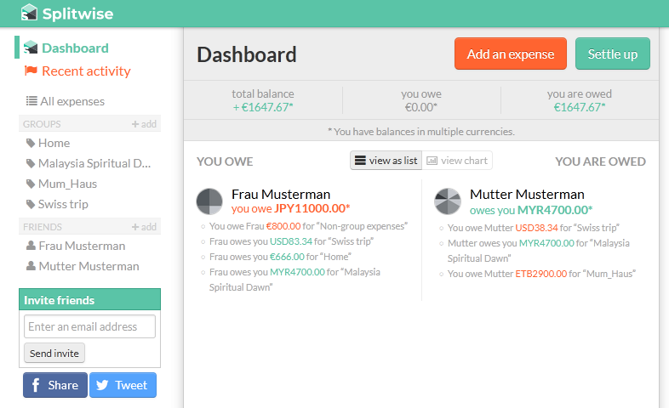
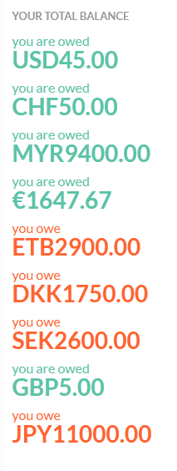
2.2.2 Owes and Owed conversion to €

Slide 23
2.3
Prediction
and
Reporting

Slide 24
2.3.1 Prediction
Aim: Developers create a mechanism to predict user’s balance for the next year based on the (repeating)expenses, income for the recent months as well as current balance. Prediction is saved as the plot in .pdf.
Problem: no data before december
solution: retrieve from Dec 2022 to Feb 2023 and predict Mar 2023

Slide 25
2.3.1 Prediction
Retrieve Data through SQL Query
Income= Subcategory_ID 101 to 105
Expenses = rest of subcategory_ID
'''SELECT DISTINCT expense_date, subcategory_id, subcategory_name, sum(base_amount) FROM Transactions AS t INNER JOIN TransactionItems AS ti ON t.id = ti.transaction_id INNER JOIN Subcategories as s ON s.id = t.subcategory_id WHERE expense_date BETWEEN date('2023-03-02', '-3 months') AND date('2023-03-02', '-2 months') AND subcategory_id NOT BETWEEN 101 AND 105 GROUP BY subcategory_id'''

Slide 26
2.3.1 Prediction
2) Sum up all base amount from income and expenses
get balance amount for prediction model
3) Sum up all base amount from income and expenses
4) create Linear model and plot the output

Slide 27
2.3.2 Reporting
creating pie chart
get percentage from each subcategory
creating list to have amount and labels
pie_chart = ax[0].pie(list_amount_1, labels = labels1, startangle=90, wedgeprops={'linewidth': 3.0, 'edgecolor': 'white'}, textprops=dict(color='white'))
plt.title('Expenses last month')
plt.legend(title = "subcategory name:",loc = 'best', prop={'size':8})
pie1 = plt.gcf()

Slide 28
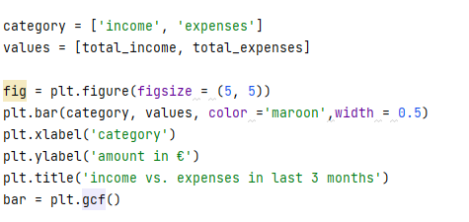
2.3.2 Reporting
creating column chart

Slide 29
2.4
Graphic
User
Interface

Slide 30
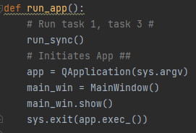
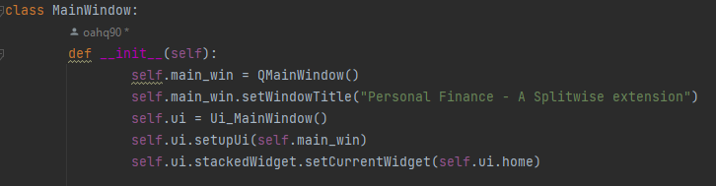
2.3 Graphic User Interface
Initializing the User Interface
Initializing the Configuration

Slide 31
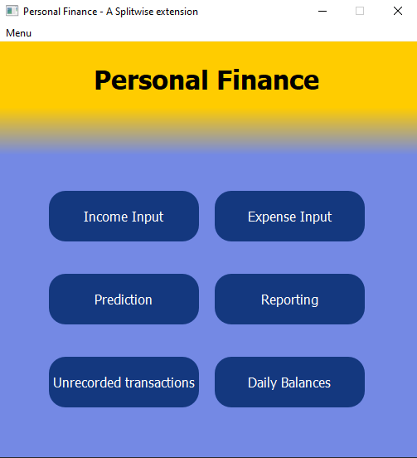
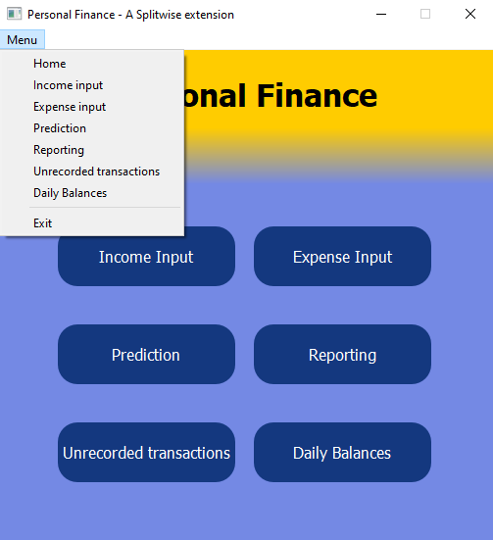
2.3 Graphic User Interface
Layout

Slide 32
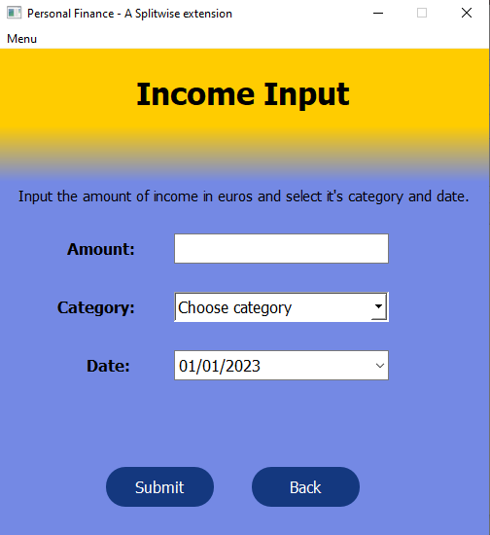
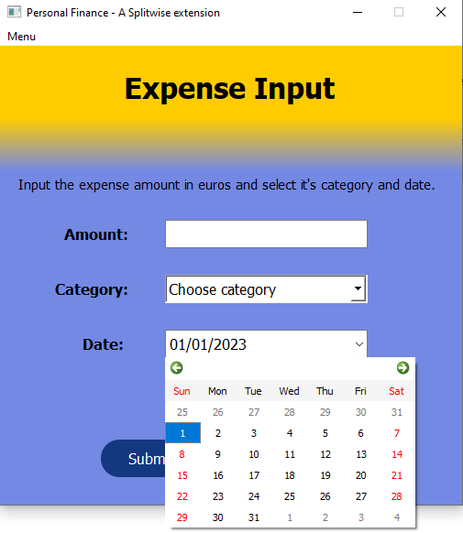
2.3 Graphic User Interface
Layout

Slide 33
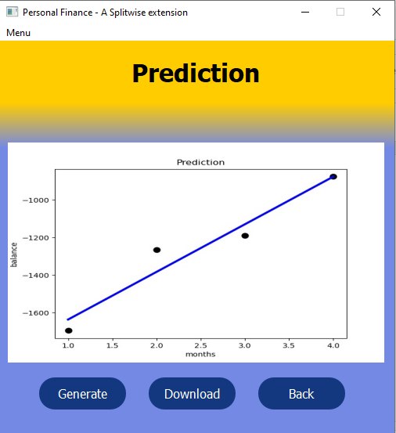
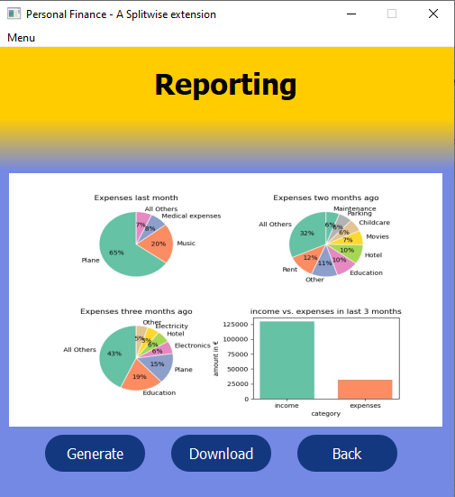
2.3 Graphic User Interface
Layout

Slide 34
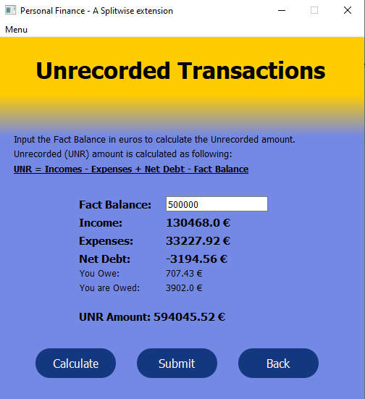
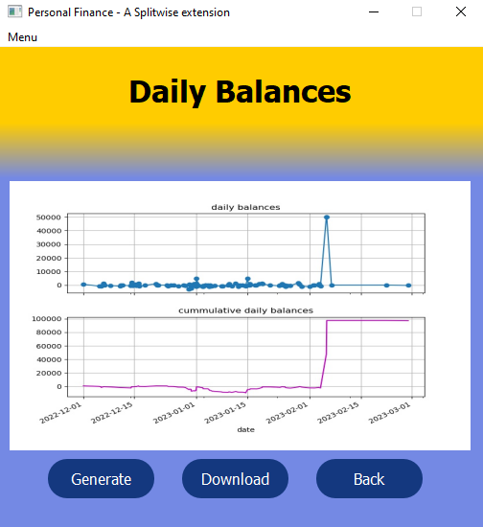
2.3 Graphic User Interface
Layout

Slide 35
3.
Limitations
and
Improvements

Slide 36
Limitations and Improvement
Limitations | Improvement
can’t retrieve data before 12/2022 on splitwise | fixing problem to get more data in the past more accurate prediction
used linear regression model: inaccurate and unspecific | try out other models for better prediction

